Slide 1
Introduction

Slide 2
Computer Vision

Slide 3
Topics
Introduction
Color and Texture
Image Coordinates, Transforms, and Resizing
Filters and Convolutions
Edges and Lines
Interest Operators, Image Matching, Image Stitching
Face Detection/Recognition
Machine Learning Overview including Neural Nets
Object Detection and Recognition with ML
Convolutional Neural Networks
CNN Applications
Motion/Optical Flow
Stereo and 3D Depth Perception

Slide 5
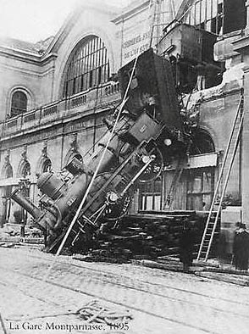
Every picture tells a story
Goal of computer vision is to write computer programs that can interpret images

Slide 6
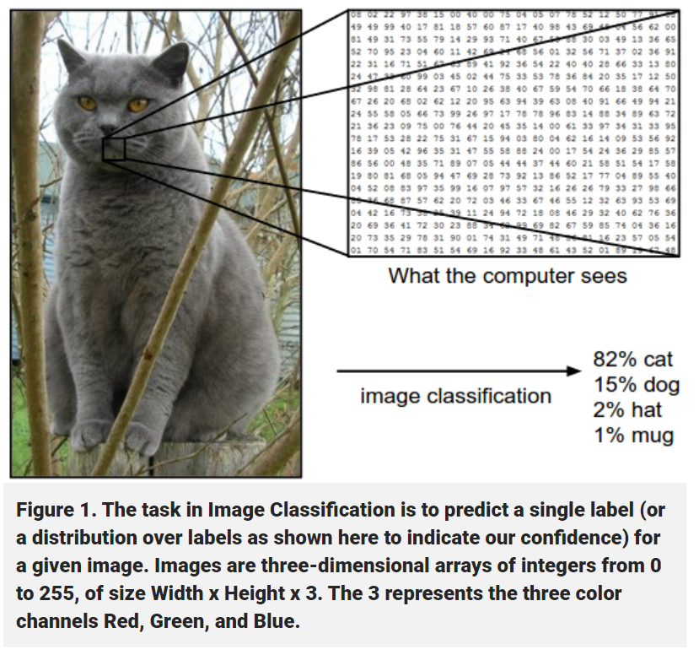
https://machinelearning.technicacuriosa.com/introduction-to-computer-vision-part-1/

Slide 7
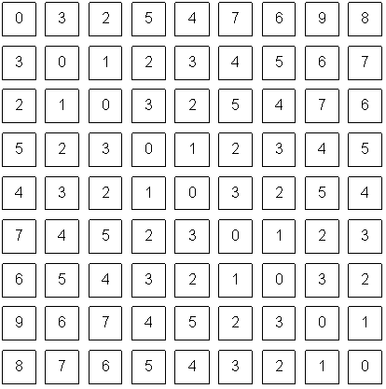
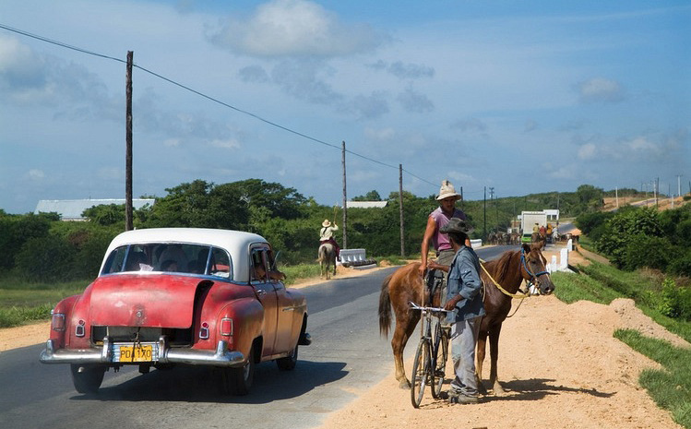
Notes:
pixels

Slide 8
The car is in front of the pole
Sky
Person
White
Horse
Car
Road
Shadow
1m
Wheel
Notes:
What do we care about in this image? color, measurement, foreground/background, potential objects, detecting particular objects

Slide 9
The car is in front of the pole
Sky
Person
Road
White
Horse
Car
Shadow
1m
Wheel

Slide 10
Computer Vision
Low Level Vision
Measurements
Enhancements
Region segmentation
Features
Mid Level Vision
Reconstruction
Depth
Motion Estimation
High Level Vision
Category detection
Activity recognition
Deep understandings

Slide 11
Computer Vision
Low Level Vision
Measurements
Enhancements
Region segmentation
Features
Mid Level Vision
Reconstruction
Depth
Motion Estimation
High Level Vision
Category detection
Activity recognition
Deep understandings
White
Shadow
1m

Slide 12
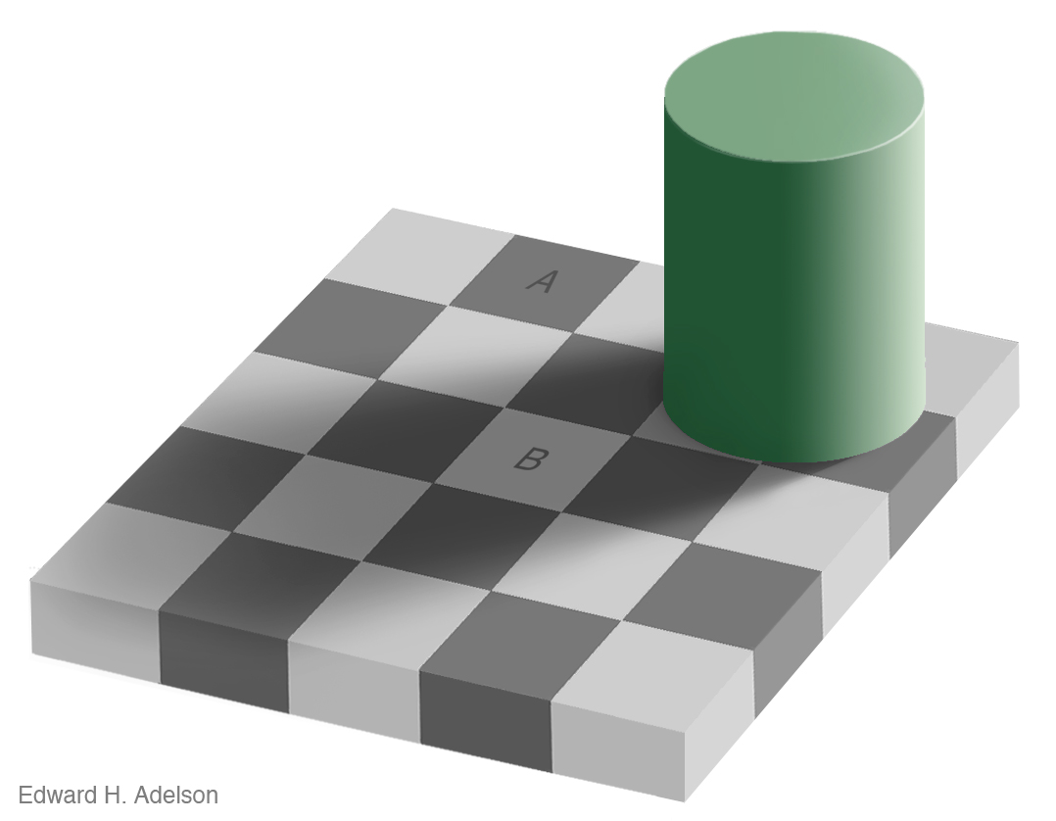
Measurement
Brightness
Notes:
See VIDEO

Slide 13
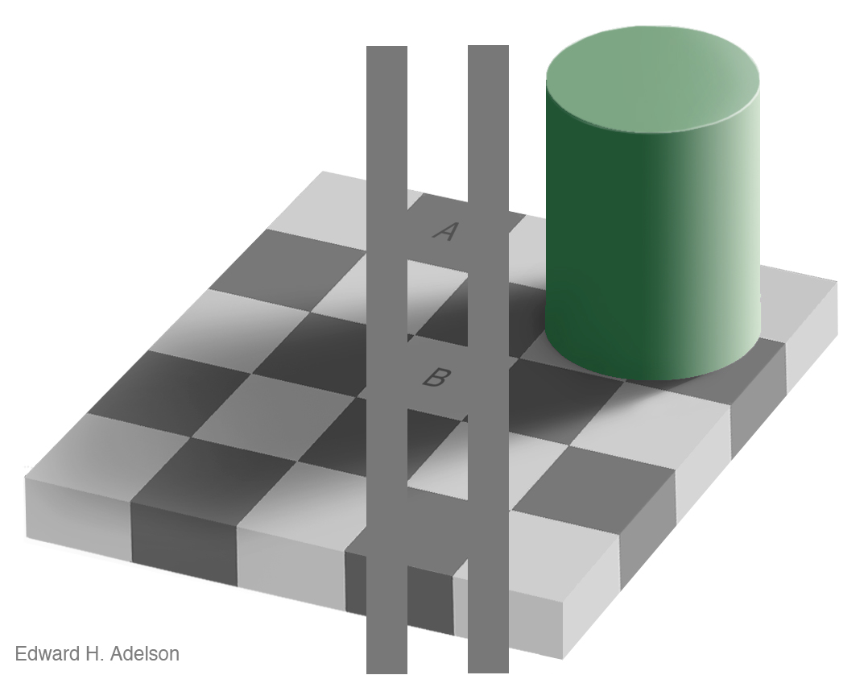
Measurement
Brightness
http://www.newworldencyclopedia.org/entry/Same_color_illusion
Slide Credit: Alyosha Efros

Slide 14
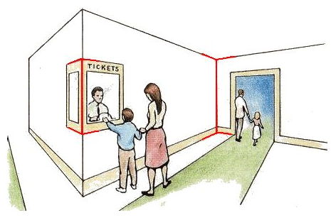
Measurement
Length
Müller-Lyer Illusion
http://www.michaelbach.de/ot/sze_muelue/index.html
Slide Credit: Alyosha Efros
Notes:
red vertical lines look like same length in image but not in reality

Slide 15
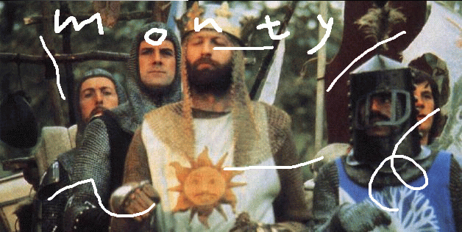
Image Enhancement
Image Inpainting, M. Bertalmío et al.
http://www.iua.upf.es/~mbertalmio//restoration.html
Notes:
About restoration

Slide 16
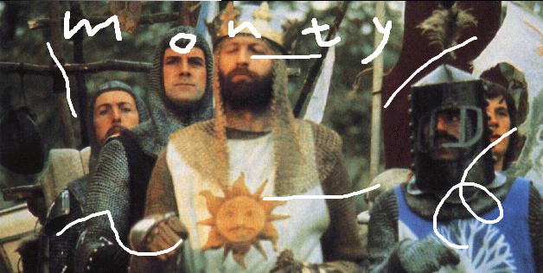
Image Enhancement
Image Inpainting, M. Bertalmío et al.
http://www.iua.upf.es/~mbertalmio//restoration.html

Slide 17
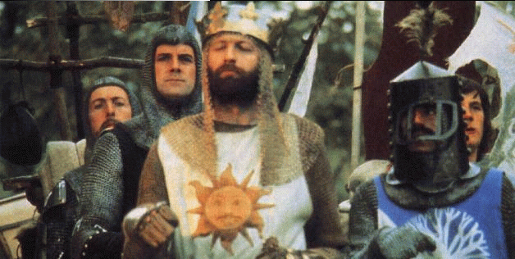
Image Enhancement
Image Inpainting, M. Bertalmío et al.
http://www.iua.upf.es/~mbertalmio//restoration.html

Slide 18
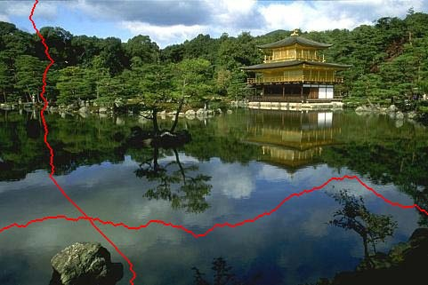
Seam Carving
less
important
[Shai & Avidan, SIGGRAPH 2007]

Slide 19
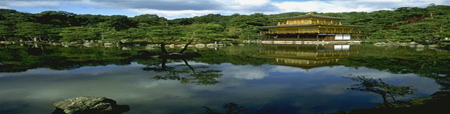
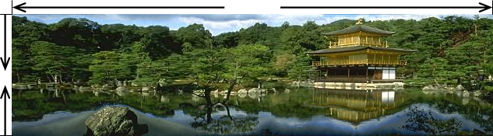
Traditional resizing uses and stretches the whole image.
Content-aware resizing uses important areas.
Extends in horizontal direction and reduces in vertical.
[Shai & Avidan, SIGGRAPH 2007]

Slide 20
Computer Vision
Low Level Vision
Measurements
Enhancements
Region segmentation
Features
Mid Level Vision
Reconstruction
Depth
Motion Estimation
High Level Vision
Category detection
Activity recognition
Deep understandings
The car is in front of the pole

Slide 21
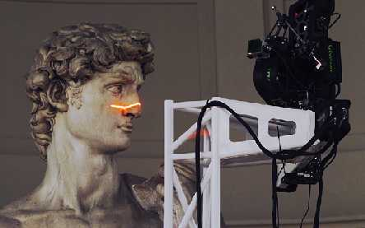
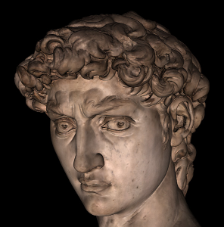
Applications: 3D Scanning
Scanning Michelangelo’s “The David”
The Digital Michelangelo Project
- http://graphics.stanford.edu/projects/mich/
UW Prof. Brian Curless, collaborator
2 BILLION polygons, accuracy to .29mm

Slide 22
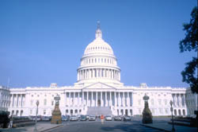
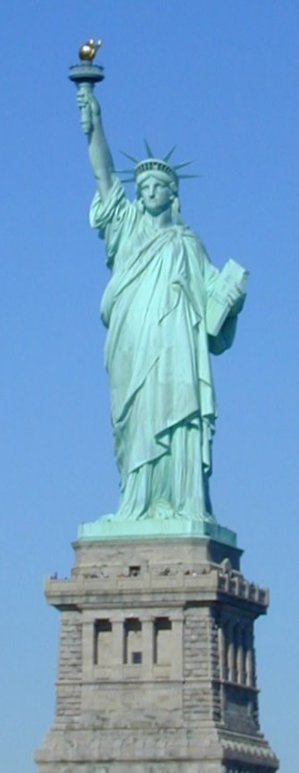
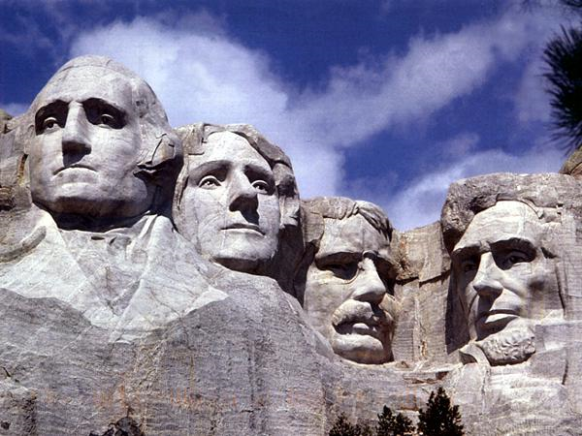
Notes:
Could these be done in the same way as David? NO.

Slide 23
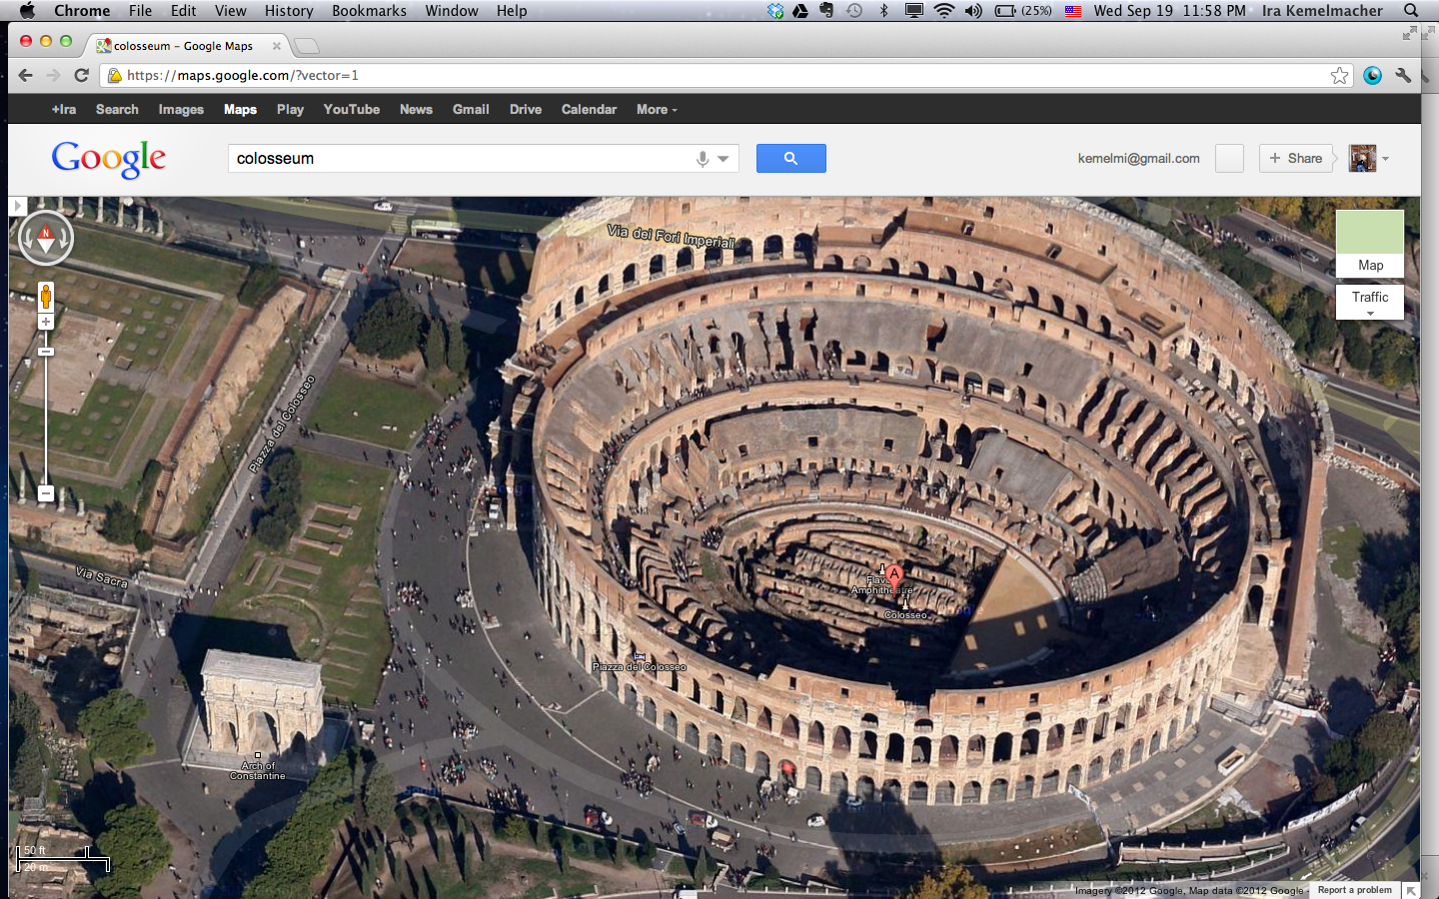
Google’s 3D Maps Structure estimation from tourist photos

Slide 24
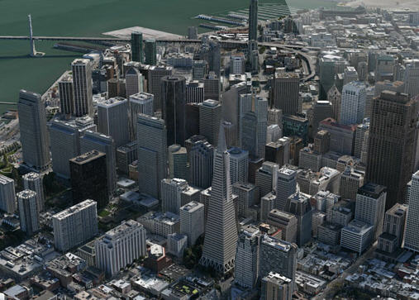
Apple’s 3D maps
https://www.youtube.com/watch?v=InIVv-LsgZE
Notes:
See link to video.

Slide 25
Computer Vision
Low Level Vision
Measurements
Enhancements
Region segmentation
Features
Mid Level Vision
Reconstruction
Depth
Motion Estimation
High Level Vision
Category detection
Activity recognition
Deep understandings
Pose estimation
Sky
Person
Road
Car
Horse

Slide 26
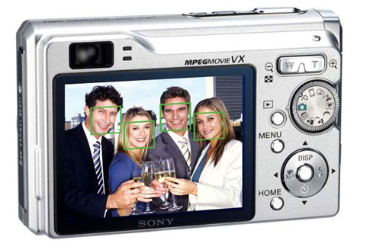
Face detection
Many new digital cameras now detect faces
Canon, Sony, Fuji, …
Source: S. Seitz
Notes:
Why would this be useful? Main reason is focus. Also enables “smart” cropping.

Slide 27
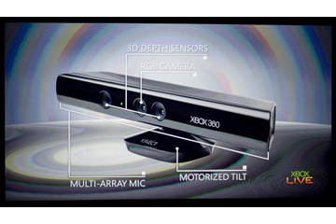
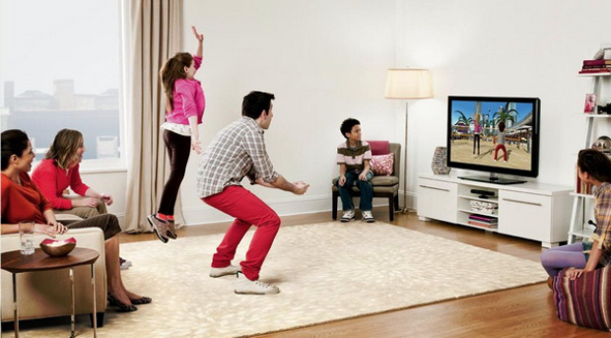
Vision-based interaction: Xbox Kinect

Slide 28
General Comments
Prerequisites—these are essential!
Data structures
A good working knowledge of C and C++ programming
Linear algebra
Vector calculus
Course does not assume prior imaging experience
computer vision, image processing, graphics, etc.

Slide 29
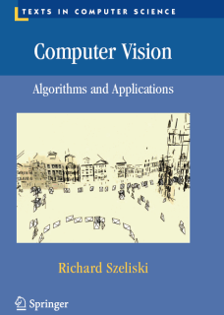
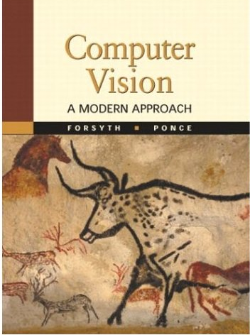
Textbooks
Computer Vision by Szeliski
Freely available for download from:
http://szeliski.org/Book/
Other books
Forsyth, David A., and Ponce, J. Computer Vision: A Modern Approach, Prentice Hall, 2003.
Stockman, George, and Linda G. Shapiro. Computer vision. Prentice Hall PTR, 2001.
Solem, Jan. Programming Computer Vision with Python: Tools and algorithms for analyzing images. " O'Reilly Media, Inc.", 2012.
Minichino, Joe, and Joseph Howse. Learning OpenCV 3 computer vision with python. Packt Publishing Ltd, 2015.

Slide 30
Other
R. Klette, Concise Computer Vision, Undergraduate Topics in Computer Science, DOI 10.1007/978-1-4471-6320-6_1, © Springer-Verlag London 2014
Nixon, Mark, and Alberto Aguado. Feature extraction and image processing for computer vision. Academic press, 2019.
Krig, Scott. Computer vision metrics: Survey, taxonomy, and analysis. Springer nature, 2014.
Gonzalez, Rafael C. Digital image processing. Pearson education india, 2009.
Elgendy, Mohamed. Deep learning for vision systems. Simon and Schuster, 2020.
Prince, Simon JD. Computer vision: models, learning, and inference. Cambridge University Press, 2012.

Slide 31
Your Turn!!

